Slide 1
Analyzing
NHANES
Survey Data
Udit Choudhary
Spring 2020 Data 606 : Capstone in Data Science

Slide 2
Literature Review
Research Papers based on NHANES :
The Association between Sleep Duration and Metabolic Syndrome: The NHANES 2013/2014 Abbas Smiley 1,* , David King 2 and Aurelian Bidulescu 3
A Prediction Model for the Peripheral Arterial Disease Using NHANES Data Yang Zhang, MD, Jinxing Huang, MD, and Ping Wang, MD
Phthalates and asthma in children and adults: US NHANES 2007–2012 Chinonso Christian Odebeatu, Timothy Taylor, Lora E. Fleming & Nicholas J. Osborne

Slide 3
The Association between Sleep Duration and Metabolic Syndrome: The NHANES 2013/2014 Abbas Smiley 1,* , David King 2 and Aurelian Bidulescu 3
Aimed to assess the association of sleep with metabolic syndrome in the 2013/2014 National Health and Nutrition Examination Survey (NHANES).
Sample size included 2737 out of 2013 and 2014 NHANES surveys.
Cross-sectional study of metabolic syndrome and sleep duration was conducted. Metabolic syndrome was defined according to NCEP ATPIII (National Cholesterol Education Program Adult Treatment Panel III) criteria.
Metabolic syndrome severity score was calculated based on actual measurement of each component, adjusted for sex and race.
The generalized additive model (GAM) was built to assess the smooth relationship between metabolic syndrome/metabolic syndrome severity score and sleep duration.
Adjustment of models were done for age, sex, race, and sitting time.

Slide 4
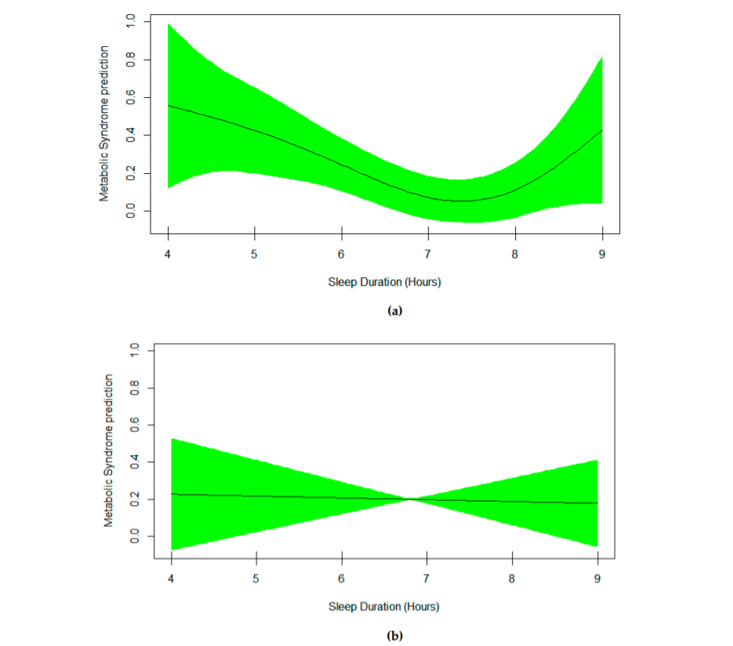
The lowest risk of metabolic syndrome was observed in people sleeping 7 hours/night. Similarly, the lowest mean metabolic syndrome severity score was observed in people sleeping 7 hours/night.
Short sleep duration was associated with higher risk of metabolic syndrome and higher scores of metabolic syndrome severity score in men.

Slide 5
A Prediction Model for the Peripheral Arterial Disease Using NHANES Data Yang Zhang, MD, Jinxing Huang, MD, and Ping Wang, MD
Aimed to build models for peripheral arterial disease (PAD) risk prediction and seek to validate these models in 2 different surveys in the US general population (NHANES 1999-2002)
Potential predicting variables included race, gender, age, smoking status, total cholesterol (TC), body mass index, high-density lipoprotein (HDL), ratio of TC to HDL, diabetes status, HbA1c, hypertension status, and pulse pressure. The PAD was diagnosed as ankle brachial index <0.9.
used multiple logistic regression method for the prediction model construction.
The final predictive variables were chosen based on the likelihood ratio test. Model internal validation was done by the bootstrap method.
The NHANES 2003–2004 survey was used for model external validation.
Age, race, sex, pulse pressure, the ratio of TC to HDL, and smoking status were selected in the final prediction model.

Slide 6
The odds ratio (OR) and 95% confidence interval (CI) for age with 10 years increase was 2.00 (1.72, 2.33), whereas that of pulse pressure for 10 mm Hg increase was 1.19 (1.10, 1.28). The OR of PAD was 1.11 (95% CI: 1.02, 1.21) for 1 unit increase in the TC to HDL ratio and was 1.61 (95% CI: 1.40, 1.85) for people who were currently smoking compared with those who were not. The respective area under receiver operating characteristics (AUC) of the final model from the training survey and validation survey were 0.82 (0.82, 0.83) and 0.76 (0.72, 0.79) indicating good model calibrations
To some extent, has a moderate usefulness for PAD risk prediction in the general US population.

Slide 7
Phthalates and asthma in children and adults: US NHANES 2007–2012 Chinonso Christian Odebeatu, Timothy Taylor, Lora E. Fleming & Nicholas J. Osborne
Aimed to assess the direction and strength of the association between urinary phthalates metabolites and current asthma in children and adults (NHANES) 2007–2012.
Data on ten urinary phthalate metabolites, self-reported questionnaires, spirometry measures, and covariates were obtained from 7765 participants.
Asthma was assessed using self-reported questionnaires for children and adults, and via spirometry measures for adults alone.
Used crude and adjusted logistic regression models to estimate the odds ratios (ORs) and 95% confidence interval (CI) per one log10 unit change in the concentration of phthalate metabolites. We further modeled the effect modification by sex.

Slide 8
Out of 10 metabolites, only mono-benzyl phthalate (MBzP) was positively associated with the prevalence of self-reported asthma in children, after adjusting for a range of potential confounders (odds ratio 1.54; 95% confidence interval 1.05–2.27).
No significant relationship was observed for adults. The association of mono-ethyl phthalate (MEP) was modified by sex, with significantly increased odds of asthma among males [boys (2.00; 1.14–3.51); adult males (1.32; 1.04–1.69)].
While no other phthalates showed a positive relationship with current asthma in males, mono-(carboxynonyl) phthalate (MCNP) and mono-(3-carboxylpropyl) phthalate (MCPP) were inversely associated with spirometrically defined asthma in adult females. A
Found no clear association between exposure to phthalates and current asthma, except for a significant relationship between MBzP metabolites and self-reported asthma in children. As a result, exposure to phthalates and asthma development and/or exacerbations remains controversial, suggesting a need for a well-designed longitudinal study.

Slide 9
References
Zhang Y, Huang J, Wang P. A Prediction Model for the Peripheral Arterial Disease Using NHANES Data. Medicine (Baltimore). 2016;95(16):e3454. doi:10.1097/MD.0000000000003454
Odebeatu, C.C., Taylor, T., Fleming, L. et al. Phthalates and asthma in children and adults: US NHANES 2007–2012. Environ Sci Pollut Res 26, 28256–28269 (2019). https://doi.org/10.1007/s11356-019-06003-2
Smiley A, King D, Bidulescu A. The Association between Sleep Duration and Metabolic Syndrome: The NHANES 2013/2014. Nutrients. 2019;11(11):2582. Published 2019 Oct 26. doi:10.3390/nu11112582

